Slide 1
Regression Model Building 1: Overview
Michael Otterstatter
BCCDC Biostats Session
July 19, 2019

Slide 2
Session overview
In this session we will discuss
Key components in the model building process
Models as a tool for exploring and describing data

Slide 3
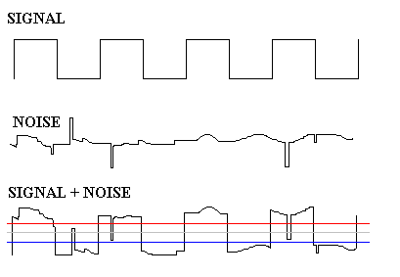
Background
Recall, data can be thought of as
observations = signal + noise
Underlying pattern
of interest
Other sources
of variation
What we actually
observe

Slide 4
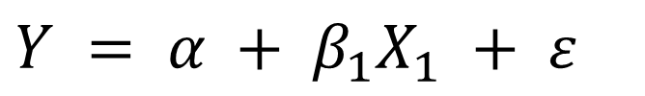
Background
Statistical models try to understand the relationship of signal and noise that generates data
observations = signal + noise
If we understand this relationship, we can
succinctly describe patterns
explain observed patterns
predict future patterns
$$Y = α + β_{1}X_{1} + ε$$

Slide 5
Model building
Building a regression model requires careful thought throughout, not simply a ‘cookbook’ activity of following predefined steps
In general, you must consider and decide
What is the purpose of my model (describe, explain, predict)?
What type of model is appropriate for my purpose and data (ordinary linear, generalized linear, etc.)?
What is the best fit model for my data?

Slide 6
Regression model basics
An ordinary linear model represents patterns in our data with a straight line, plus unexplained (error) variation
predictor
variable
intercept parameter
ε
Y
response
variable
slope
parameter
error
‘residual’
α
X₁

Slide 7
Ordinary linear model assumptions
Relationship between response and predictor(s) is linear
Errors are normally distributed and have constant variance
Errors are independent of one another

Slide 8
Regression model basics
Generalized linear models (GLIMs) expand on ordinary linear models in two ways:
Response variable Y assumed to have a distribution from the exponential family
Normal (ordinary linear regression, ANOVA, etc.):
Binomial (logistic regression), Poisson
Others (gamma, negative binomial, multinomial, inverse Gaussian, etc.)
The expected value of the response variable (μ_{i}) is related to a linear equation of predictors through a link function (g)

Slide 9
Regression model basics
In Binomial (logistic) regression, a logit link is typically used
In Poisson regression, a log link* is typically used
* natural (base e) logarithm

Slide 10
GLIM assumptions
Relationship between transformed response g(μ_{i}) and predictor(s) is linear
Residuals should be evenly distributed and have constant variance (but not assumed to be normally distributed)
Residuals are independent of one another
g(u)

Slide 11
Descriptive modeling
In this session we focus on descriptive modeling
Having decided on the aim of our model (to describe), we turn our attention to
What type of model is appropriate for describing my data (ordinary linear, generalized linear, etc.)?
What is the best fit model for my data?

Slide 12
Descriptive modeling
Descriptive modeling aims to
summarise or represent data in a compact manner
capture associations between dependent and independent variables
generate hypotheses (but not test hypotheses)
Different from
explanatory modeling: hypothesis testing - based on underlying causal theory
predictive modeling: model as a tool for predicting new observations

Slide 13
Our data
As an example, we consider individual-level clinic data from STI sentinel surveillance (provided by Clinical Prevention Services, BCCDC)
Chlamydia and gonorrhea diagnoses (2006-17) were linked to infectious syphilis diagnoses (up to 12-months after)
Patient-level information is based on case report forms and linkage to HIV surveillance data
Our interest is to describe the associations between syphilis diagnosis and the patient characteristics

Slide 14
What type of model?
The outcome of interest (syphilis dx: yes or no) is binary – what type of model would be an appropriate choice?

Slide 15
What type of model?
The outcome of interest (syphilis dx: yes or no) is binary – what type of model would be an appropriate choice?
We use binomial (logistic) regression as an illustrative example
In the accompanying R script, we analyse the probability of syphilis diagnosis in association with patient-level covariates (demographics, previous STI diagnoses)

Slide 16
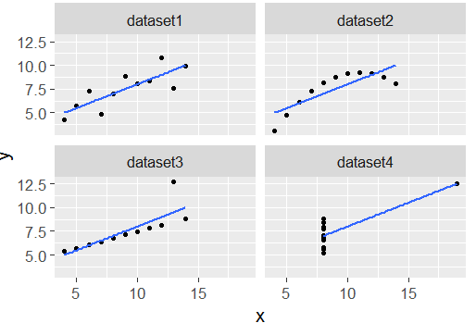
Visualising your data and model
Recall Anscombe’s quartet: 4 different data sets having identical regression fits!

Slide 17
Visualising the data
Use standard descriptive statistics (frequencies, mean ± SD, etc.) to summarise data
Plots are generally most helpful for seeing and communicating patterns
Use univariate tests (chi-square, t-test, etc.) for seeing simple patterns in data

Slide 18
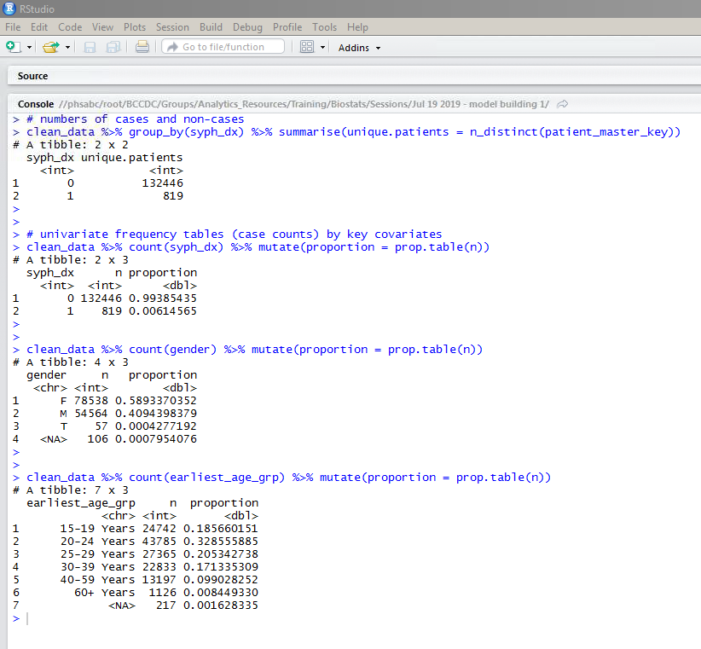
Visualising data: descriptive summaries

Slide 19
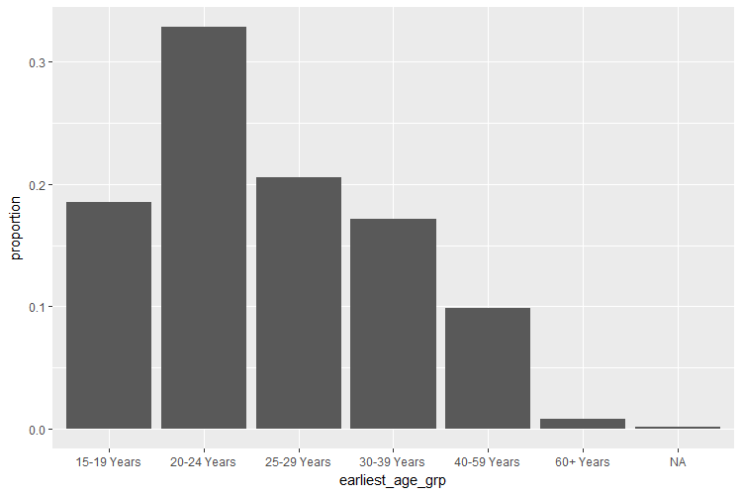
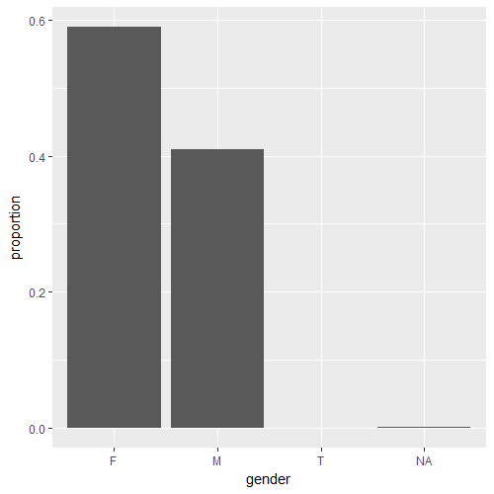
Visualising data: simple plots

Slide 20
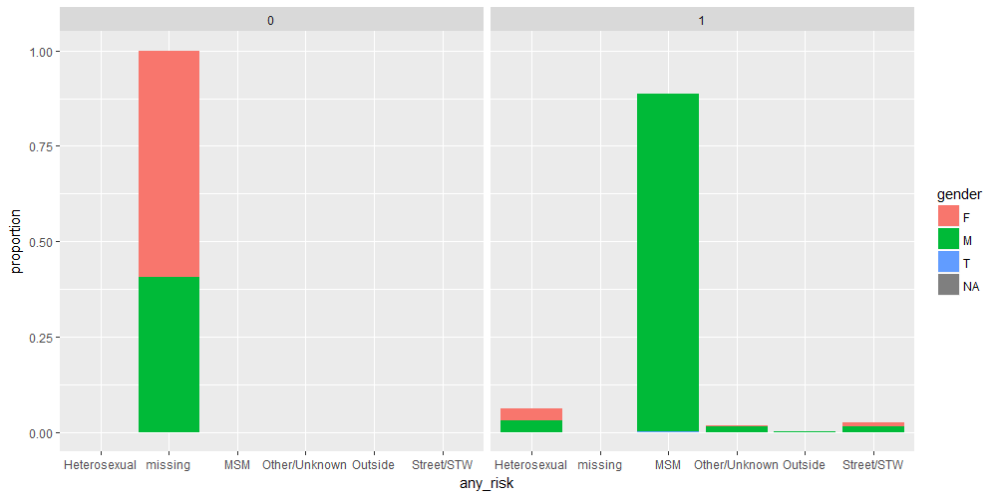
Visualising data: simple plots

Slide 21
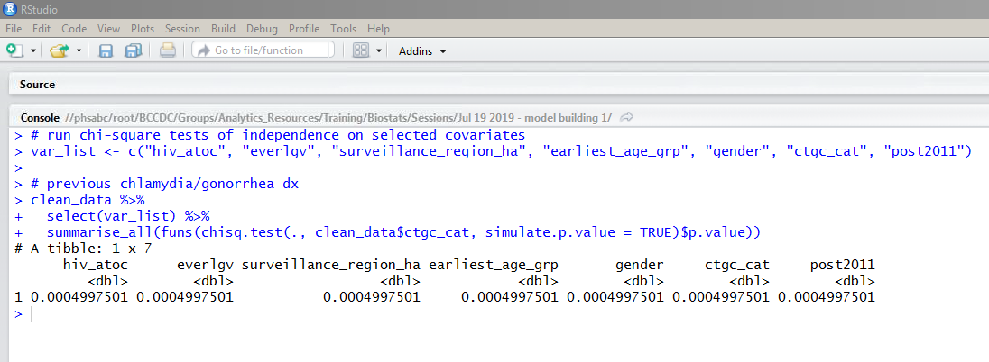
Visualising data: summary statistics

Slide 22
Building a model
There are various approaches to model building
begin with ‘full model’, containing all relevant covariates, then possibly remove covariates to achieve a better fit
begin with simple model (e.g., only one covariate) and build by iteratively adding covariates and assessing model fit
Regardless of approach, it is essential to assess the fit of candidate models against the observed data
generate predicted (‘fitted’) values from model and compare against data
generate residuals (‘errors’) from model and assess fit

Slide 23
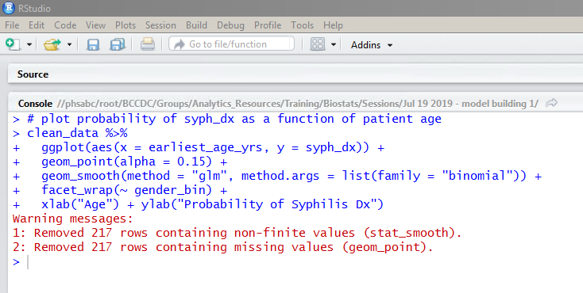
Building a model
As an example, consider the age-only model:
P(syphilis dx) = age group

Slide 24
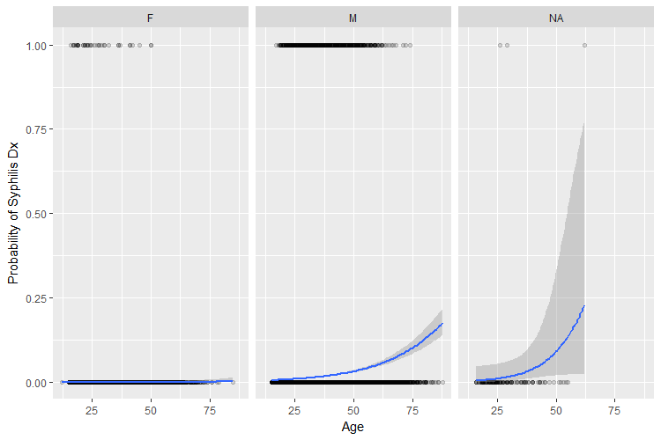
Building a model

Slide 25
Building a model
Continued next time with assessing model fit and running model comparisons!

